Slide 1
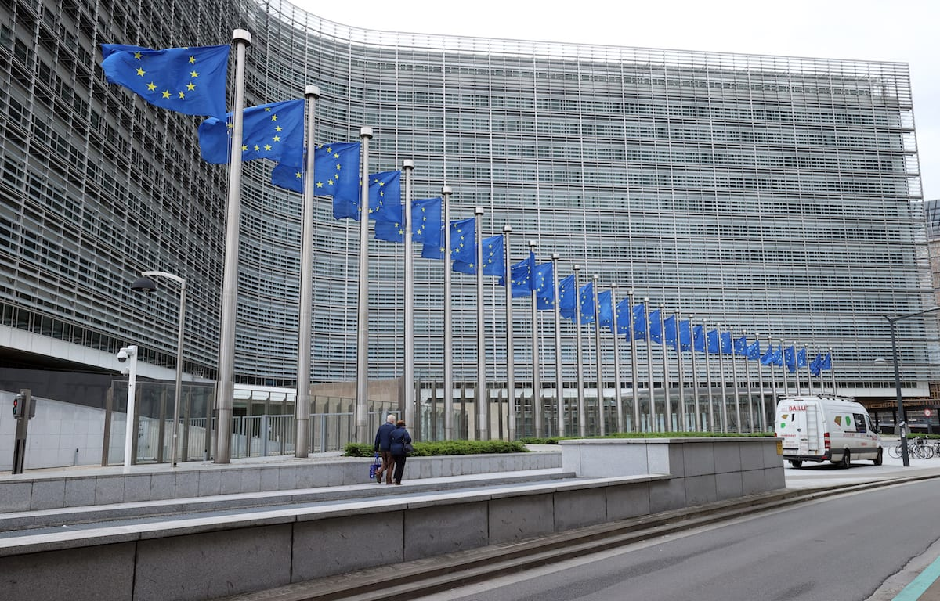
the European Commission and the Council: An Overview
An introduction to the system of the European Union

Slide 2
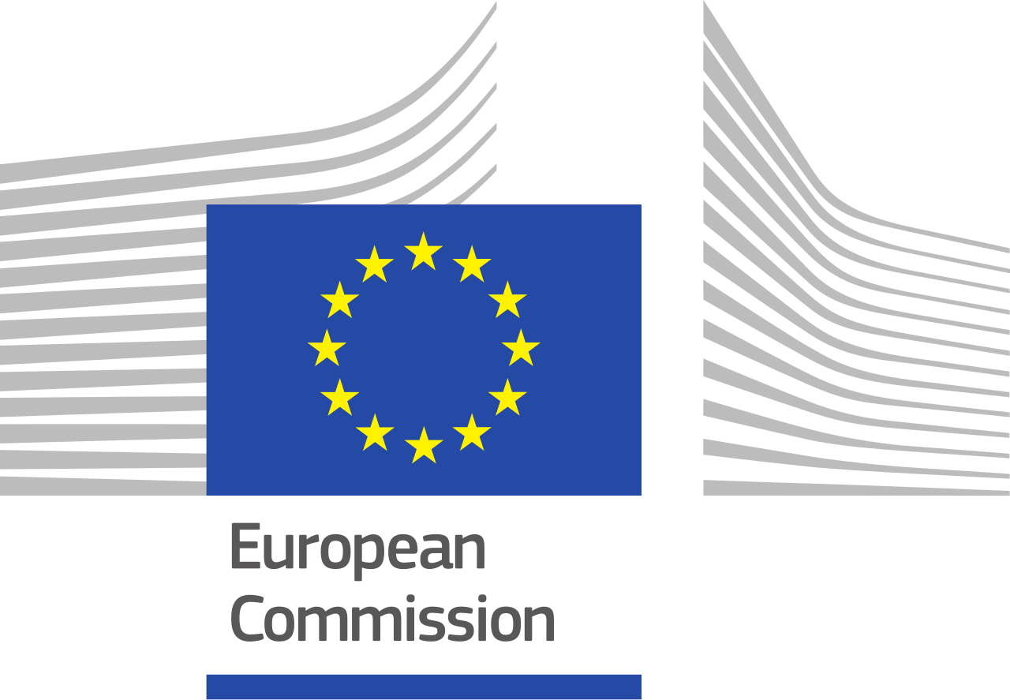
What is the
european commission?
The Commission is the EU’s executive body, as its main role is to oversee the implementation of EU policy.
Only institution that can propose new EU laws
Ensures laws are implemented
Manages the EU budget
Enforces competition rules
Negotiates trade agreements
Notes:
The European Commission is often described as the EU’s executive body. Its role is to ensure the implementation of EU policy, to handle the budget of the EU, to protect competition across member states, represent the EU on the world stage, and to propose specific EU legislation. It ensures that EU laws are implemented correctly across member states . In addition, the Commission manages the EU budget, enforces competition rules to prevent unfair market behavior, and negotiates trade agreements on behalf of the EU with other countries or organizations.

Slide 3
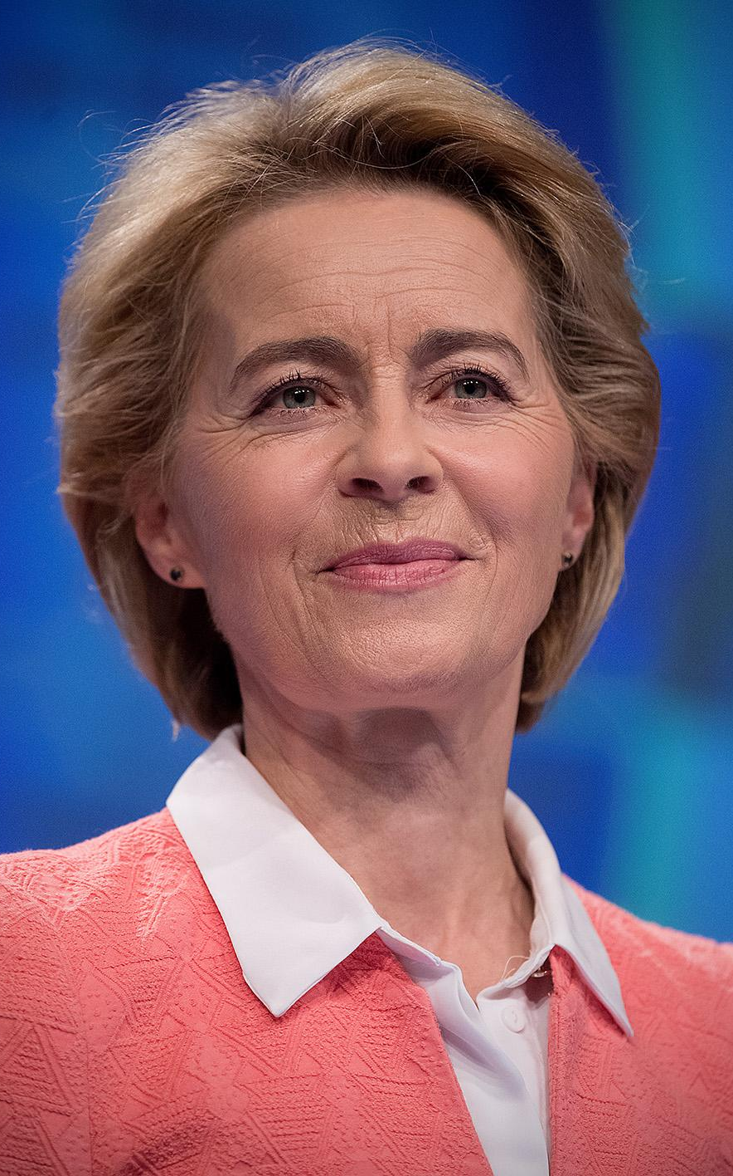
commission personnel
The Commission is comprised of the President, the College of Commissioners, and its administrative staff.
Led by a Commission President (currently Ursula von der Leyen)
Chosen by European Council and approved by European Parliament
5‑year term
Political leadership: 27 Commissioners (one per member state)
Comprise the “College of Commissioners”
Each Commissioner oversees a policy area
Administrative staff: College is supported by around 33,000 staff
Organized into DGs (Directorates‑General) headed by Commissioners
Notes:
The Commission has both political leadership and administrative staff. It is led by the Commission President and the College of Commissioners. There are 27 commissioners, one from each EU member state, and each commissioner is responsible for a specific policy area. The Commission is also supported by a large administrative staff of about 33,000 people who work in departments called Directorates-General, which handle specific policy areas like agriculture, health, or climate policy.

Slide 4
how powerful is the
commission?
Strengths
Limits
Strong in proposing laws and enforcing rules
Proposes and drafts laws, but needs approval from Council and Parliament
Represents the EU internationally
Negotiates with other entities on behalf of EU
Limited resources
Relies on member states to implement laws and courts to enforce them
European Council sets agenda
Sets the term for trade talks
Commission can only advise Council on most issues
Notes:
The Commission has significant influence because it proposes legislation and helps shape the EU policy agenda. It also represents the EU internationally by negotiating agreements with other countries. But its power is limited because its proposals must be approved by the Council and the European Parliament before they become law. The Commission also depends on member states to actually implement and courts to enforce EU policies within countries. Further, the Eropean Council mandates the Commission negotiates with third parties on its behalf, and sets the terms for trade negotiations.

Slide 5
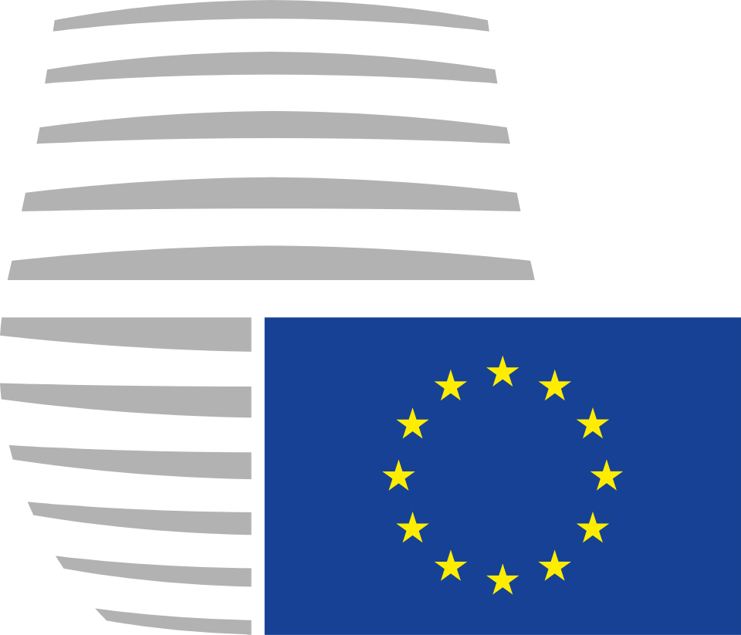
What is the
european Council?
The Council sets the EU’s long-term agenda.
Made up of elected heads of EU member states
Handles major political issues and shapes EU policy:
Treaty changes across EU
Enlargement of EU to new member states
Development of Common Foreign Policy
Creation of Monetary Union
the Euro
Notes:
The European Council brings together the heads of state or government from all EU member states. In 1974, it was founded as an informal summit by heads of state to direct EU strategy, but in 2009, amendments to the Lisbon treaty turned it into an official, top-level institution of the EU.
It is the highest EU authority. Its main role is to set the EU’s overall political direction and priorities. It cannot create legislation directly, as it focuses on major political questions and its long-term agenda. For example, the European Council has played a major role in treaty changes, the expansion of the EU to new member states, and the development of common policies like the euro and foreign policy cooperation.

Slide 6
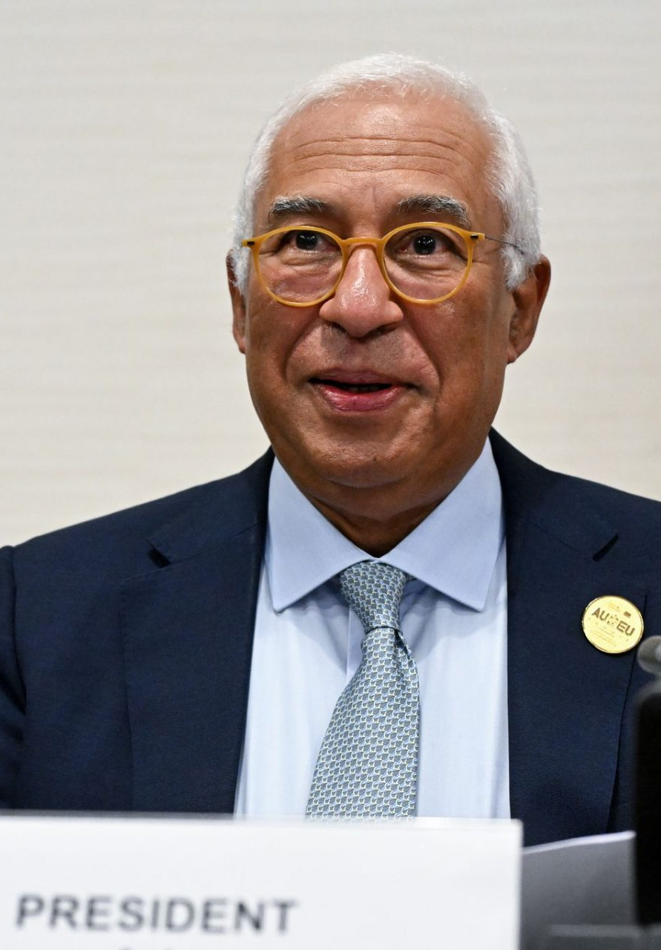
leadership of the
european Council
The Council Leadership is comprised of its President, the President of the European Commission, and representatives from EU member states.
President (currently Charles Michel)
Elected by qualified majority for 2.5 year terms, max of 2 terms
Responsible for convening and chairing meetings
Can call extraordinary sessions during crises
Membership from EU member states limited to Heads of State/Govt
Policy since 2009
Notes:
The European Council is led by its President, who is elected by the member states for a two-and-a-half-year term and can serve up to two terms. The President’s main responsibilities are to organize meetings, chair discussions, and help coordinate cooperation between national leaders. Membership in the European Council is limited to the President, the President of the Commission, and the heads of state or government from each EU country.

Slide 7
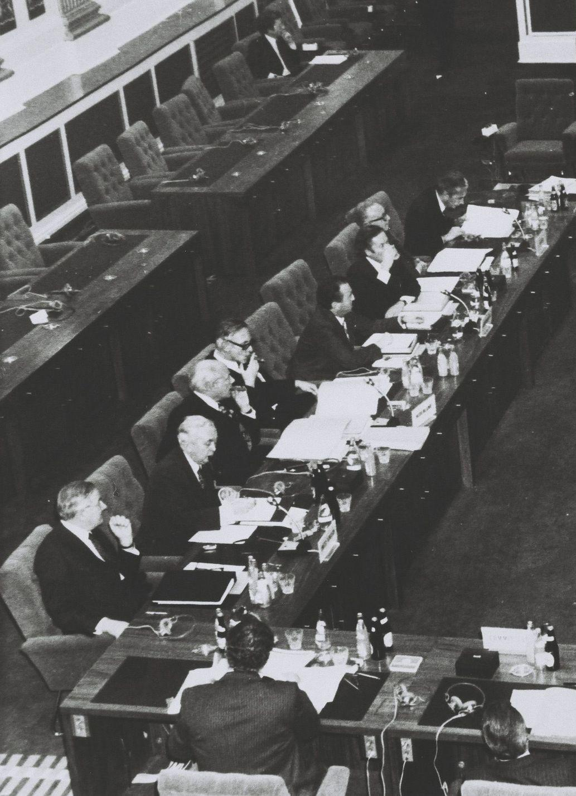
decision-making of the
european Council
The Council’s “Conclusions” are used to identify issues of concern in the EU, and to outline deadlines and courses of action.
Meets at least 4 times per year
Lays out specific issues and objectives for the EU to address
No formal legislative power, sets agenda for EU policy and legislation
Results published as formal “conclusions” at end of meetings
Agreed upon by all participants (consensus based)
Notes:
The European Council usually meets at least four times per year, but it can call emergency meetings in times of crisis. In meetings, leaders confront major political issues facing the EU and decide on the priorities to focus on. Decisions are typically made through consensus, which requires much negotiation. While their meetings usually last 2 days, they can take much longer for negotiations. The outcomes are published as official “conclusions,” which outline the EU’s goals and future actions.

Slide 8
What is the
Council of the EU?
The Council of the EU , also called the “Council of Ministers,” is the EU’s legislative body representing the 27 member states.
Made up of national ministers of EU member states
Ministers work in their policy area
Along with European Parliament, a key body in EU law making
Presidency is held by a national government, rotates every 6 months
Chairs all Council meetings and prepares the agenda
Expected to act as a neutral chair
Committee of Permanent Representatives from member states
Made up of senior civil servants
Prepares the work of the Council of the EU
Notes:
The Council of the European Union, also known as the Council of Ministers, represents the governments of the EU’s member states. It is one of the main legislative bodies of the EU. National ministers attend meetings depending on the topic being discussed. For example, agriculture ministers meet to discuss agricultural policy, while finance ministers meet to discuss economic issues. Along with the European Parliament, the Council of the EU is responsible for negotiating and adopting EU laws.
Council meetings occur 70 to 80 times per year, and are organised according to policy subject.
Presidency is held by a national government for 6 motnhs, and each president is expected to work closely with their predecessor and their successor. These 3 representatives outline an 18-month policy agenda for the Council.

Slide 9
responsibilities of the
Council of the EU
Five Key Responsibilities
1
Negotiate EU Laws
2
Coordinate Policies
3
Implement EU Common and Foreign Security Policies
4
Conclude Trade Agreements
5
Adopt EU Budget
Notes:
The Council of the EU has several key responsibilities. First, it negotiates and adopts EU legislation together with the European Parliament. It also coordinates, or monitors, economic and policy decisions among EU member states. In addition, the Council helps manage the EU’s foreign and security policy, approves international trade agreements, and works with Parliament to adopt the EU’s annual budget. These responsibilities make it one of the most important institutions for representing national governments in EU decision-making.

Slide 10
key takeaways
European Commission
European Council
Council of the EU
Proposes and implements policy
Sets long‑term political agenda
Represents member states in law-making

